Slide 1

Graph-Based Airport Connectivity and Flight Route Optimization System
By Brian Tran, Robert Baumgarten, and Benjamin Voor

Slide 2
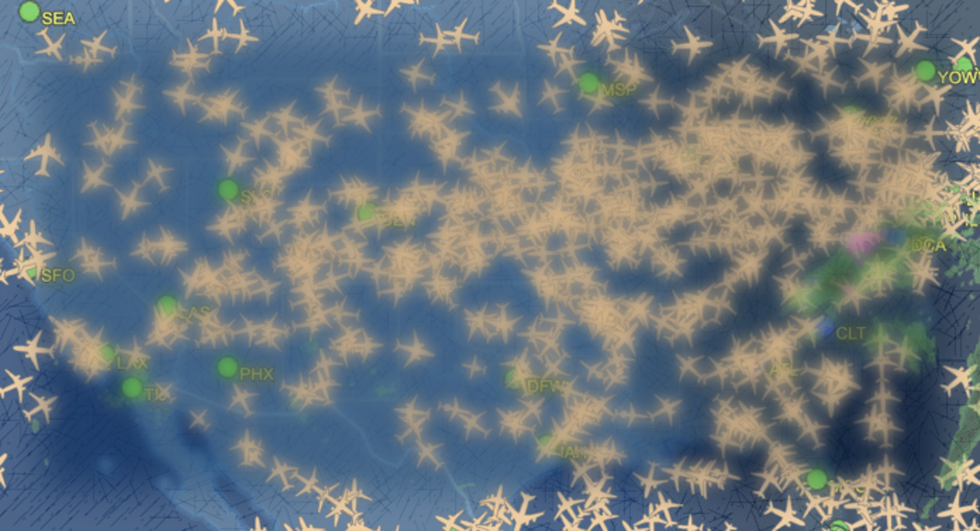
Project Summary
Using C++ in Replit, we took a csv dataset containing 384 entries of airport codes, locations, distances, and cost values, and converted it into a graph data structure by creating a vector of vertices representing each airport and an adjacency matrix of edges representing each flight.
We used Dijkstra’s algorithm in order to calculate the shortest path between two airports.
We also separated two letter state codes from a string in the comma separated values in order to group vertices together by state

Slide 3
Project Tasks
Task 1 - Populate the Graph object from the .csv file
Task 2 - Find the shortest path between airports
Task 3 - Find all shortest paths from an airport to a state
Task 4 - Find the shortest path between airports, but with a given number of stops
Task 5 - Count inbound and outbound flights of each airport
Task 6 - Create an undirected graph for tasks 7-8
Task 7 - Use Prim’s algorithm to populate a Minimal Spanning Tree (“MST”)
Task 8 - Use Kruskal’s algorithm to populate a Minimal Spanning Tree (“MST”)

Slide 4
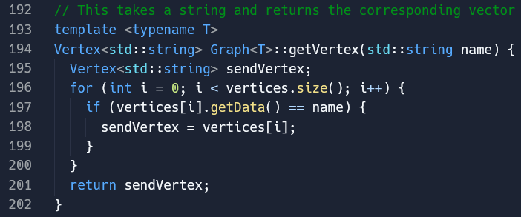
Graph implementation
Templates were taken from Canvas modules for the graph algorithms, heaps, and queues. The following changes were made:
Changed parameters to strings when inserting an Edge or Vertex
Added fields Distance and Cost to Edge
Created getVertex function, which gets the vertex corresponding to the string parameter

Slide 5
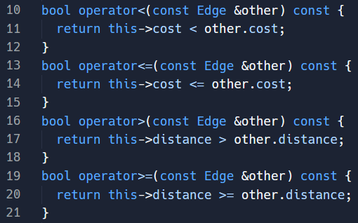
Heap implementation
The heaps used in earlier tasks needed to compare distance, while the heaps used in later tasks needed to compare cost, so the comparison operator was equipped to handle both situations.

Slide 6
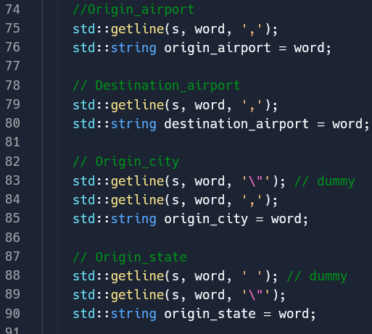
Task 1: Graph<std::string> task_1(const std::string file)
Contributed by Benjamin.
Open file using fstream. Checked if opened.
While loop through .csv’s rows.
Convert row to “stringstream.”
Store row to variables using “getline,”
Delimited by commas and quotation marks
Close file

Slide 7

Task 2
Contributed by Brian.
This function takes the airport graph, the origin airport code, the destination airport code, finds the corresponding vertex object for each airport and Dijkstra’s algorithm to calculate the shortest available path between the two airports.
If there isn’t an available path, the function will print out a message saying “None”, but if there is, the function will display airport codes on the shortest path there, including all of the intermediate ones. Finally, the program will display the total length and cost of the shortest route.

Slide 8
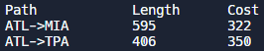
Task 3
Contributed by Robert
Similar to Task 2, Task 3 uses Dijkstra’s algorithm to find the shortest path between two airports.
However, before calling the algorithm, the vertices with the inputted destination state are obtained so that Dijkstra’s algorithm is called for each. These vertices are obtained by checking every vertex of the Graph for the given state, and if the states match, the vertex is inserted into a vector.
The function body for Dijkstra’s algorithm differs between Tasks 2 and 3 by printing each path, distance, and cost in a table-like structure.

Slide 9

Task 4
Contributed by Robert
This task has a lot in common with Task 2, only it also keeps track of the number of stops it takes to get from one airport to the other.
Dijkstra’s algorithm is used in a function the same as in Task 2, only it has a vector of strings storing the stops. This variable allows for the printing of both the path and its number of stops via the path.size() function from the vector STL, unless that number is greater than the number of stops inputted.

Slide 10
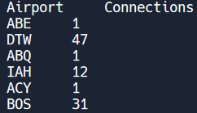
Task 5
Contributed by Benjamin.
Took Graph as parameter.
Looped for vertices ‘i’.
Initialized count. Retrieved vertex.
Skipped vertex if it was empty.
Looped for edges[i][...]. Also Looped for edges[...][i].
Each loop called a helper function:
Retrieved origin and destination of edge.
If either were empty, returned false. If either equaled the vector, returned true.
If helper was true, count was incremented.

Slide 11
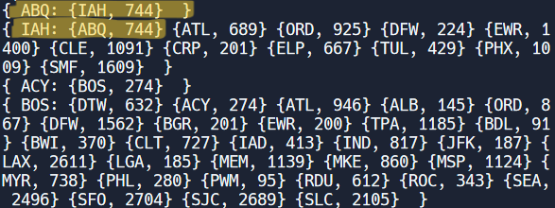
Task 6
Contributed by Brian.
This function takes a pre-existing airport graph, which should be created from task 1, and copies it into a new graph. It then goes through every edge, and checks to see if the reverse flight edge exists; if it doesn’t, it creates the reverse flight edge with the same cost, but if it does exist, the function changes the edge with the higher cost to the lower cost.

Slide 12
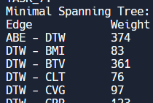
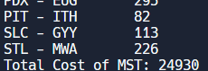
Task 7
Contributed by Robert
This task involved using Prim’s algorithm to create a Minimal Spanning Tree.
Using an unweighted Graph made from Task 6, Task 7 keeps track of vertices in the MST, assigns key values for each vertex, and updates the heap by least cost rather than by distance.
The graph is disconnected, so there’s no example output

Slide 13
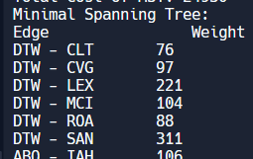
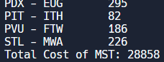
Task 8
Contributed by Robert
Like Task 7, Task 8 creates a Minimal Spanning Tree. Instead of using Prim’s algorithm, however, this task relies on Kruskal’s algorithm, which only adds edges that are not part of a cycle.
There are additional functions for assisting with disconnected edges such as find() and Union().

